Slide 1
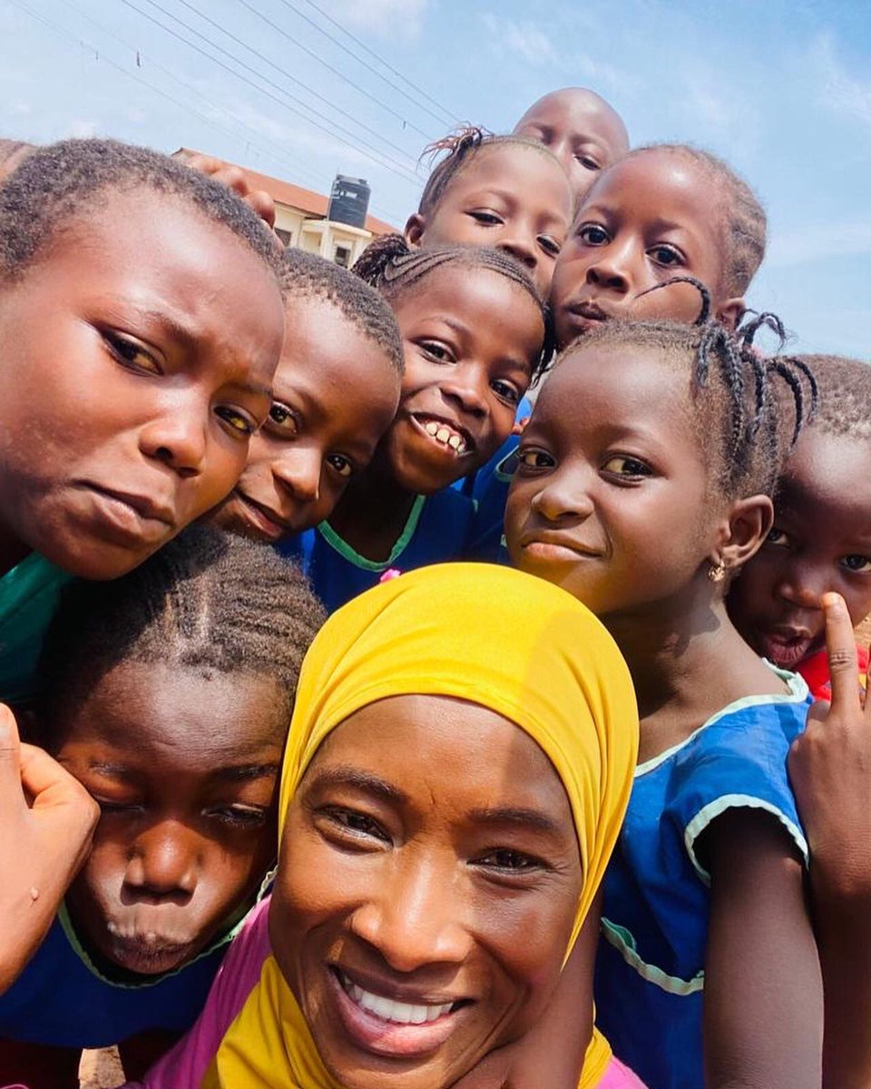
AFRICA HAPPINESS REPORT
A general look into
the ‘least’ happy region of the world
A visualization project by
Tung Quan Hoang (z5296486)
https://twitter.com/TheSMJourney/status/1537442772549963777

Slide 2
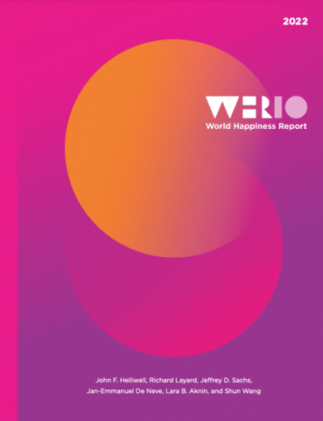
World Happiness Report
The World Happiness Report is a publication that analyze and ranks the happiness of most countries and territories of the world based on responses to Gallup World Poll and a number of quality of life factors.
The report is a publication of the Sustainable Development Solutions Network - a global initiative of the United Nations - and is powered by the Gallup World Poll data.
https://worldhappiness.report/

Slide 3


Target Audience
Target Audience
The target audience has:
Interest in the topic of Happiness The audience is generally those who are interested in happiness, how it is ‘calculated’ by professionals, and where their country lies on the ‘happiness’ map.
No profound knowledge of visualization and data This target audience may not have deep knowledge of complex visualizations and techniques, so simplicity and usability is preferred.
The target audience may also be:
Interested in Africa in general These viewers may range from casual readers to researchers who may use this as a basis for further research into happiness in Africa.
Finding ideas for their own project This target audience may be students like me or aspiring Data Analysts who want to take on personal projects and are finding inspirations.

Slide 4
Data Sources and Key Variable Definitions
The main data source of the Report is the 2022 release of the Gallup World Poll covering years from 2005-2021. The variables used in this presentation include, but are not limited to:
Life Ladder: a scale from 0-10, representing the bottom to the top of a ladder and describing how the respondent currently feels about their life.
Social Support: the national average of binary responses (either 0 for No and 1 for Yes) to the question asking if the respondent feel that they would have friends and relatives to count on in times of trouble.
Freedom to Make Life Choices: the national average of binary responses to the question asking if the respondent is satisfied with their freedom to make decisions in life.
Generosity: the residual of regressing national average of response to the question asking if the respondent has donated money to charity in the past month on GDP per capita.
Corruption Perception: the national average of binary responses to two questions: “Is corruption widespread throughout the government or not” and “Is corruption widespread within businesses or not?”. The overall corruption perception will be the average between two questions. If the perception of government corruption is missing, the perception of business corruption will be used as the overall perception.

Slide 5
Data Sources and Key Variable Definitions
The other two main key variables and data sources are:
(Log) GDP per capita: a statistics available from the December 16th, 2021 update of the World Development Indicators (WDI) developed by the World Bank. The GDP figures for Taiwan, Syria, Palestine, Venezuela, Djibouti and Yemen are from the Penn World Table 10.0
Healthy Life Expectancy: indicate healthy life expectancies at birth and are based on the data extracted from the World Health Organization’s (WHO) Global Health Observatory data repository (Last updated on December 4th, 2020). The source data are only available for the years 2000, 2010, 2015, and 2019, so interpolation and extrapolation are used to match the report’s sample period (2005-2021).
For a full overview of all variables used by the report and more details on how these variables are obtained and calculated, please refer to the “Statistical Appendix 1 for Chapter 2”, available at the Appendices & Data page of the World Happiness Report. The main data file that is used for this presentation is “Data for Table 2.1”, in combination with “List of Countries by Continent 2022” available at worldpopulationreview.com for the purpose of mapping countries to continents.

Slide 6
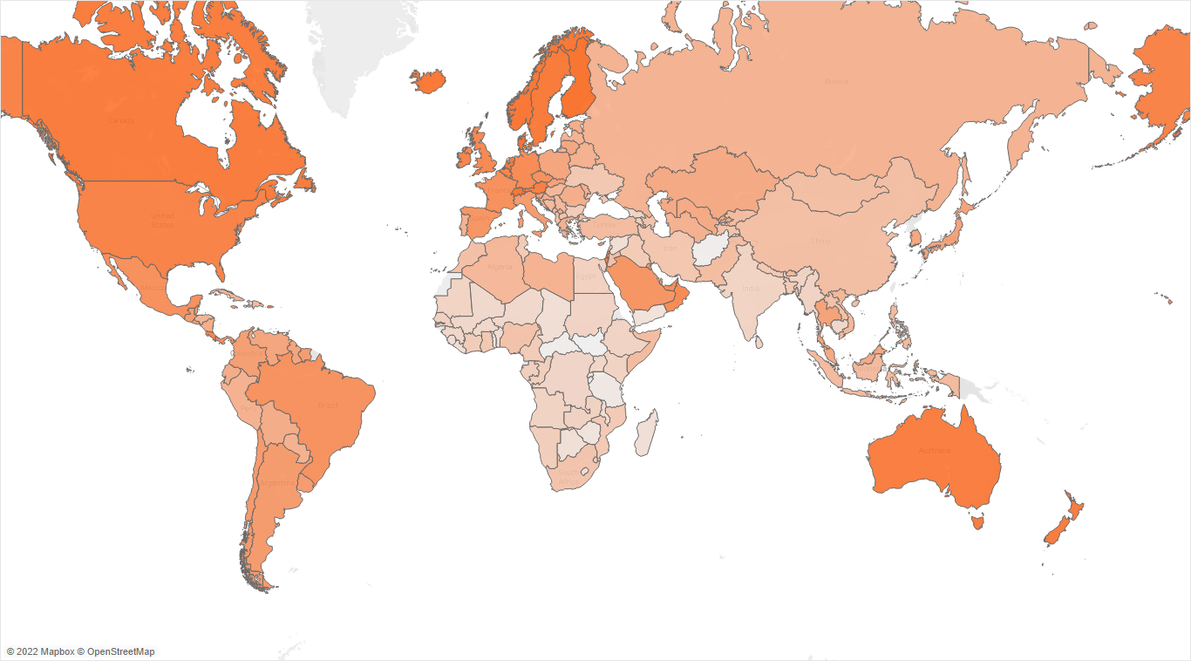

An Over(head)view of National Happiness
A map chart of average national Life Ladder throughout the period from 2005-2021 clearly highlights different regions with different levels of happiness.
Countries with higher living standards in Europe, North America, and Oceania tends to have higher Life Ladder.
While Asia also has relatively low Life Ladder, African countries stand out with many countries approaching the lowest levels of Life Ladder.
Average Life Ladder
Figure 1. Average National Life Ladder from 2005-2021.

Slide 7
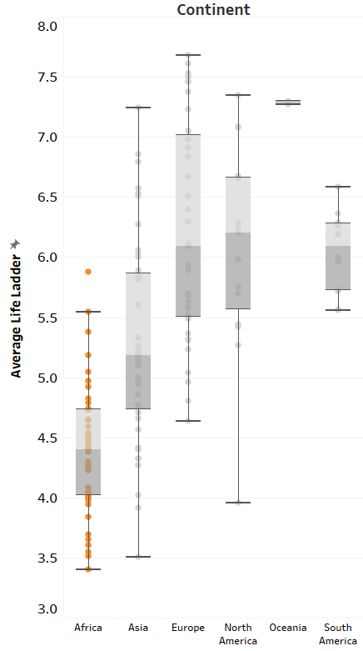
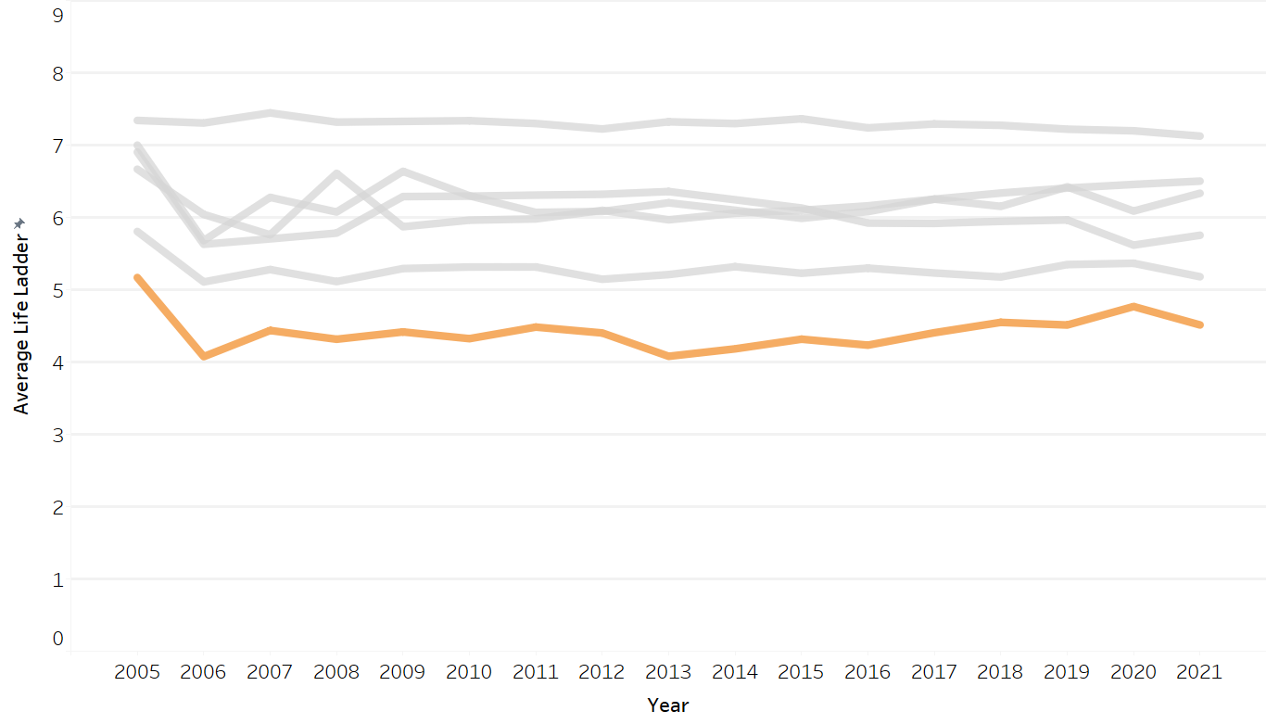

Africa: an unhappy continent
A line graph denoting yearly Life Ladder by continent and a boxplot showing the average Life Ladder by continent from 2005-2021 reiterate that African countries are relatively “unhappy” compared to other nations, despite showing signs of positive changes by the years.
Figure 2. Yearly Average Life Ladder by Continent from 2005-2021.
Figure 3. Average Life Ladder by Continent.

Slide 8
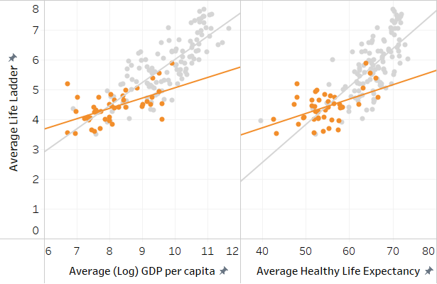
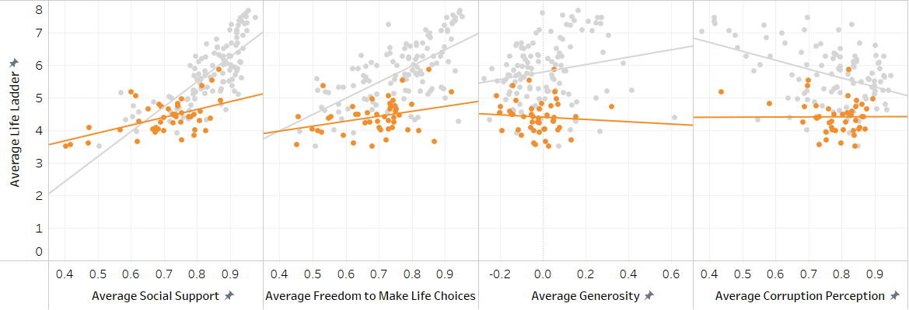
What correlates with happiness in Africa and the world?
Two common factors that are normally associated with a person’s happiness are their standard of living and general wellbeing. These two factors could be represented by the two measures: (Log) GDP per capita and the Healthy Life Expectancy (at birth). The higher these measures are, the happier the people of a country.
While other factors also correlate with happiness, albeit a lesser degree, this might not be true for Africa. For example, Corruption Perception in African Countries is seemingly not correlated with Life Ladder; however, this might be due to Corruption Perception of these countries being high in every country despite the Life Ladder.
Figures 3.1 and 3.2. Correlation between various factors with Life Ladder.

Slide 9
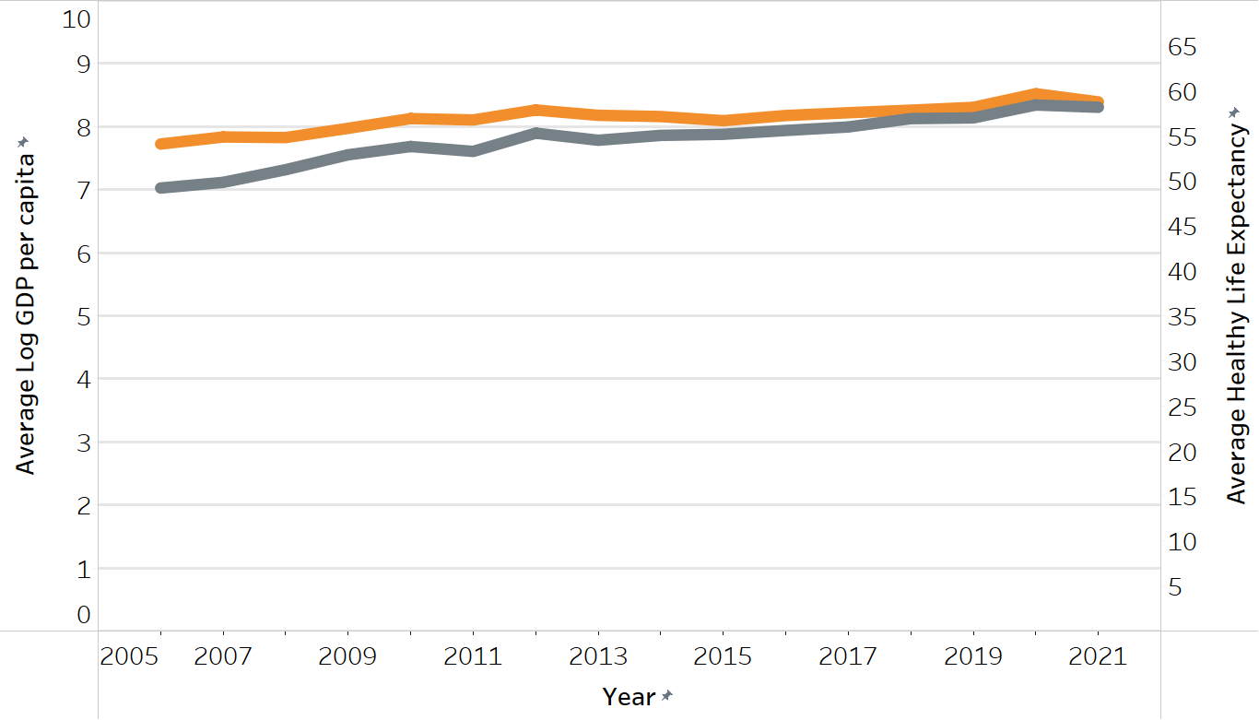
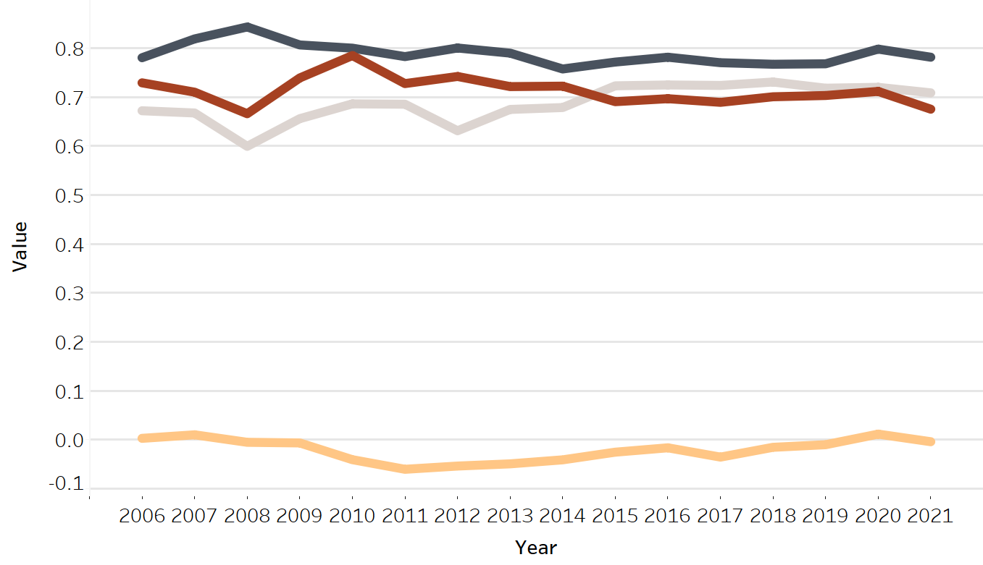


Africa: an unhappy continent
- As we know previously, the Life Ladder of Africa as a whole has been steadily rising over the years. This trend evidently holds true for the continent’s Healthy Life Expectancy and (Log) GDP per capita.
- For measures obtained from the Gallup World Poll, only Freedom to Make Life Choices and Corruption Perception seemed to experience the same pattern, albeit to a much lesser degree. This might indicate that these factors also affect Life Ladder, but not to the extent of Healthy Life Expectancy and (Log) GDP per capita.
Figure 4.1 and 4.2. Yearly Average Healthy Life Expectancy, (Log) GDP per capita, Social Support, Corruption Perception, Generosity, and Freedom to Make Life Choices of Africa by from 2005-2021.
*Some statistics for the year 2005 are missing for Corruption Perception and Generosity, so this year will be excluded for these graphs.

Slide 10


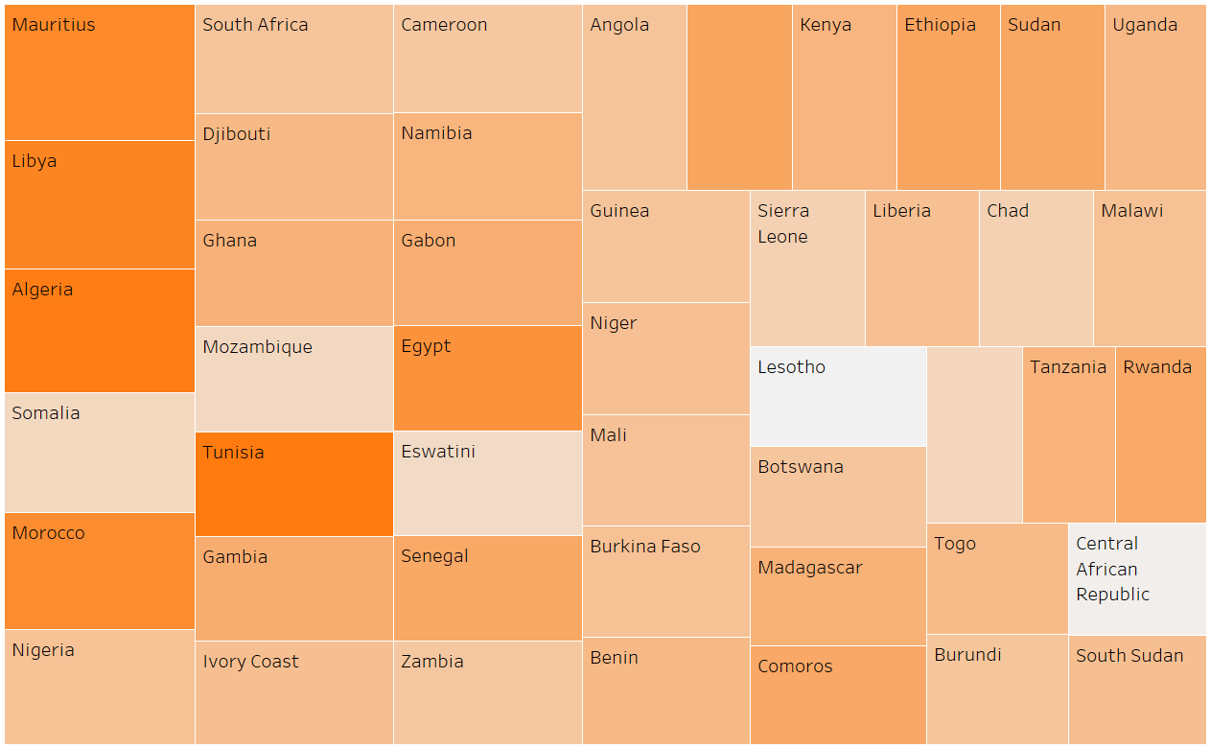
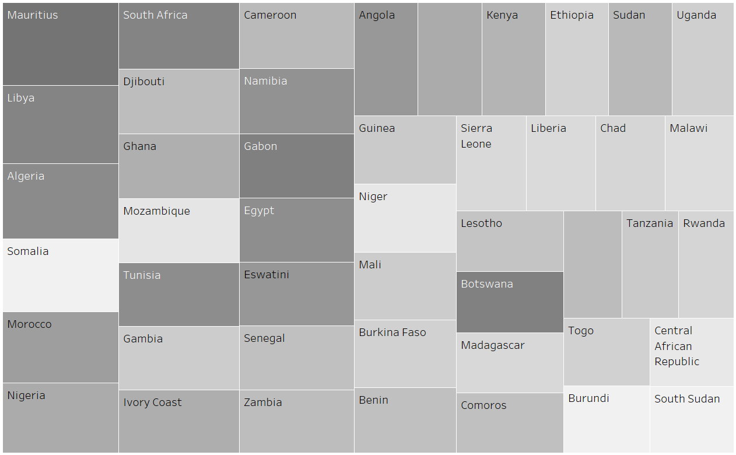
What really matters?
From previous observations, we can safely conclude that in the end, the standard of living, associated with GDP per capita, and general wellbeing, represented by Healthy Life Expectancy (at birth), are the two key factors that determine happiness, both in Africa in particular and in the world in general. Nonetheless, there might certainly be countries that do not conform to this pattern, but overall, these two factors still seemingly have the greatest impact on a country’s happiness levels.
Figure 5.1 and 5.2. African countries’ Life Ladder (size) and Healthy Life Expectancy and (Log) GDP per capita (color).

Slide 11
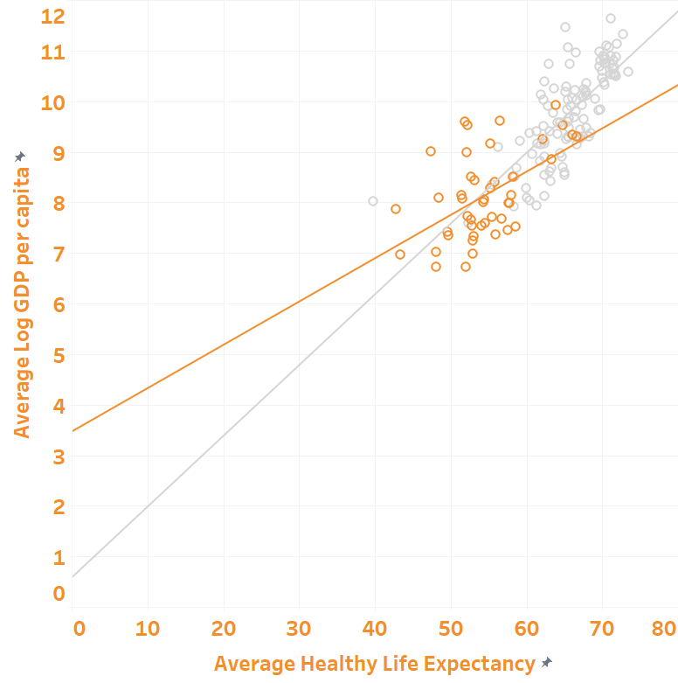
What matters more?
GDP vs. Healthy Life Expectancy
The standard of living and the people’s life expectancy are normally associated with each other. The reasoning is that with better standard of living, individuals can afford better healthcare in general, increasing the national healthy life expectancy as a whole.
A look at the scatter plot confirms this assumption, both for the world and for Africa, with GDP per capita and Healthy Life Expectancy positively correlate with each other. Now, it is normal to also assume that the standard of living may lead to higher life expectancy, and not vice versa. The question then is:
Is the standard of living the deciding factor for happiness ?
Figure 6. Scatterplot of Average Log GDP per capita and Average Healthy Life Expectancy

Slide 12

Too Long, Didn’t Read
Africa is the ‘least’ happy region in the world
The reason might be because of low standard of living, life expectancy, freedom to make life choices, and high perception of corruption
Nonetheless, the standard of living and healthy life expectancy are seemingly the two leading factors, the former of which possibly being more prominent
https://mobile.twitter.com/canoncna

Slide 13
THE END
Thank you for reading!

